Slide 1
The OpenSE Cookbook: A practical, recipe based collection of patterns, procedures, and best practices for executable systems engineering for the Thirty Meter Telescope
Robert Karban, CAE Project Systems Engineer
Jet Propulsion Laboratory,
California Institute of Technology
18-22 June 2018 – OMG Technical Meeting, Boston, MA, USA
The cost information contained in this document is of a budgetary and planning nature and is intended for informational purposes only. It does not constitute a commitment on the part of JPL and/or Caltech. Reference herein to any specific commercial product, process, or service by trade name, trademark, manufacturer, or otherwise, does not constitute or imply its endorsement by the United States Government or the Jet Propulsion Laboratory, California Institute of Technology.
© 2018 California Institute of Technology. Government sponsorship acknowledged.

Slide 2
Agenda
Introduction
TMT and MBSE Approach
Cookbook Principles
Selected Cookbook Patterns

Slide 3
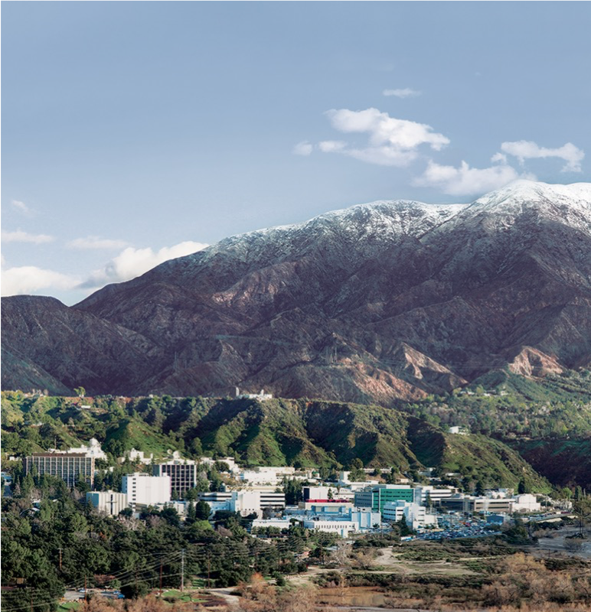
NASA Jet Propulsion Laboratory (JPL)
Located in Pasadena, CA
NASA-owned ”Federally-Funded Research and Development Center”
University-operated
~5,000 employees
Contract Negotiations
Program Direction & Reporting
Funding & Oversight

Slide 4
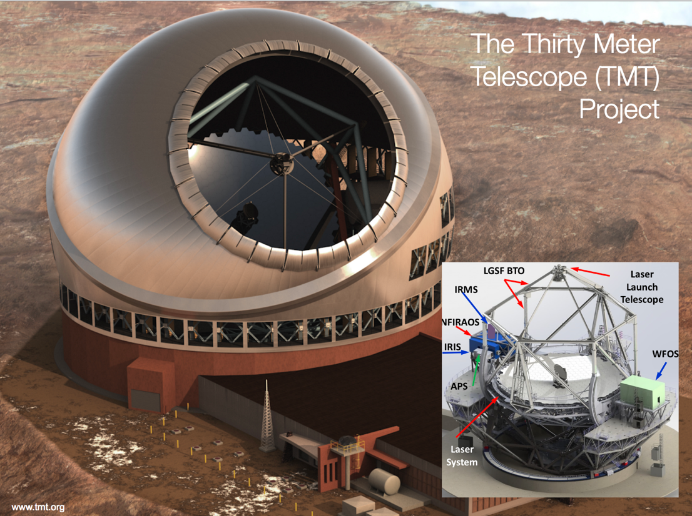
Application of SysML
The Thirty Meter Telescope (TMT) Project
TMT
Developed by TMT International Observatory (TIO)
JPL participates in several subsystems of TMT
APS (and AO) team uses MBSE to analyze requirements, produce design, and perform analysis
Alignment and Phasing System (APS)
Sensor responsible for measuring the pre-adaptive optics wavefront quality
www.tmt.org
Notes:
Developed by TMT International Observatory (TIO)
JPL participates in several subsystems of TMT
APS (and AO) team uses MBSE to analyze requirements, produce design, and perform analysis
Alignment and Phasing System (APS)
Sensor responsible for measuring the pre-adaptive optics wavefront quality

Slide 5
Agenda
Introduction
TMT and MBSE Approach
Cookbook Principles
Selected Cookbook Patterns

Slide 6
TMT applies “Hybrid” Systems Engineering Approach
Traditional SE
Clear, defined deliverables
Easily accessible
Shallow learning curve
Simple traceability
MBSE
Understanding behaviors of a system
“Rich” capability to represent complex systems
Exploit the advantages of each approach

Slide 7
TMT MBSE Approach delivers consistent, verifiable engineering products
Define an executable SysML model
Use the model to analyze the system design and verify requirements on power consumption, mass, duration, pointing errors, etc.
Produce engineering documents
Requirement Flow Down Document
Operational Scenario Document
Design Description Document
Interface Control Documents
Use standard languages and techniques, and COTS tools where practical to avoid custom software development

Slide 8
TMT MBSE follows a well defined Modeling Approach
Object-Oriented Systems Engineering Method (OOSEM), but with additional activities focusing on building an executable model
Use case driven model development
Challenges:
JPL is a supplier for a number of subsystems of the TMT (the customer)
Model is used by a number of teams, including TMT
ESEM = OOSEM + Executability
Notes:
Executable Systems Engineering Method (ESEM) augments the OOSEM activities by enabling executable models
OOSEM maps onto ISO systems engineering process and integrates top-down (functional decomposition) approach with model-based approach
ESEM produces executable SysML models that verify requirements
Includes a set of analysis patterns that are specified with various SysML structural, behavioral and parametric diagrams
Also enables integration of supplier/customer models

Slide 9
Systems Model is developed according to ESEM using Cookbook Patterns
Define APS Mission boundaries
Elaborate Conceptual Architecture
Capture Component Behavior and Characteristics
Specify Interactions between Components
Run Analyses

Slide 10
Agenda
Introduction
TMT and MBSE Approach
Cookbook Principles
Selected Cookbook Patterns

Slide 11
OpenSE Cookbook addresses Systems Engineering Concerns
Provides goal oriented guidance using patterns, e.g.
How-to Verify Requirements
How-to Roll-up Technical Resources
Driven by Systems Engineering Workflows
Enables combining patterns into more complex recipes
Demonstrates how to build system models with available tooling - How/where do I start?
Includes known usages in TMT production model as reference
Commoditizes Executable Systems Engineering
Notes:
(vs text books focus on SysML language and examples)

Slide 12
OpenSE Cookbook combines different aspects
Update 2012 “Cookbook for MBSE with SysML”
Focus on structure and requirements using European FP7 Active Phasing Experiment (APE) as case study
Include Patterns developed for TMT
Focus on behavior and analysis workflows
Guided by ESEM methodology
Describe tooling support provided by JPL Systems Environment
OpenSE model library provides commonly used elements
Instructional examples
Application to actual engineering team, i.e. TMT
Template Models and recommended model organizations

Slide 13
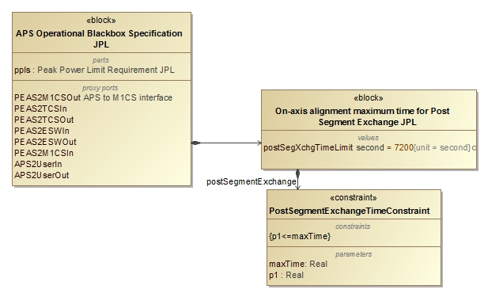
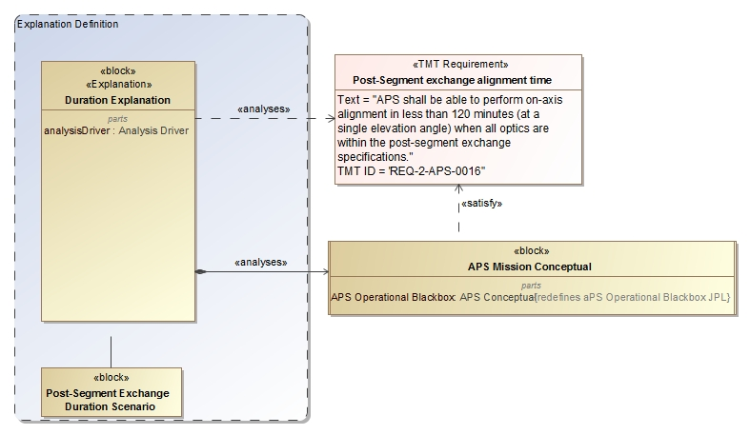
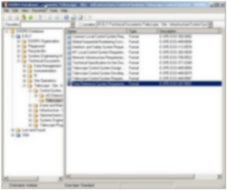
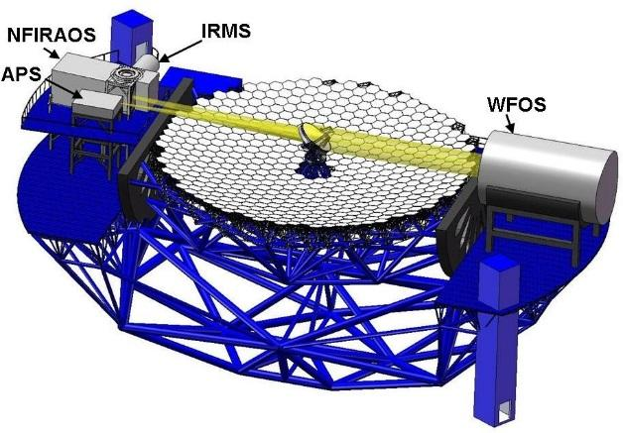
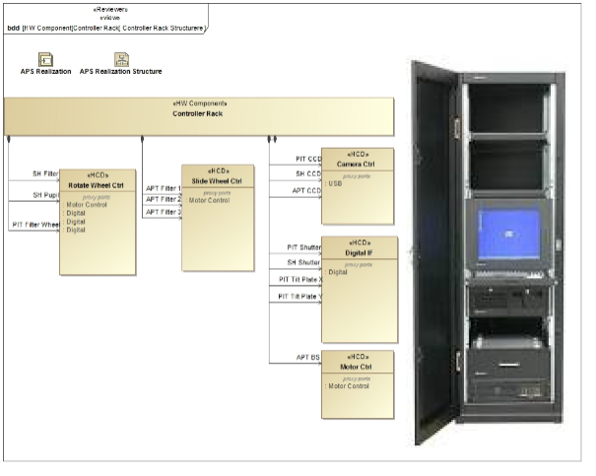
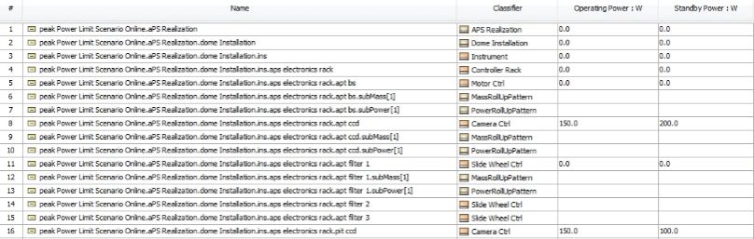
TMT Analysis workflows drive the OpenSE Cookbook
Update Requirements
2
Analyze Conceptual Design
3
3
Analyze Realization Design/Specification
4
1
Pass/fail
Change request
Max duration Post-segment exchange: 7200s 5000s
Number of exposures of 45s 4 6
Max peak power consumption in dome: 8.5kw 8.1kw Number of motors with 50W 10 12
1
6
Produce Engineering Documents
5
Notes:
Touches on all modeling capabilities: construction, visualization, analysis, management, exchange and integration, collaboration and workflow

Slide 14
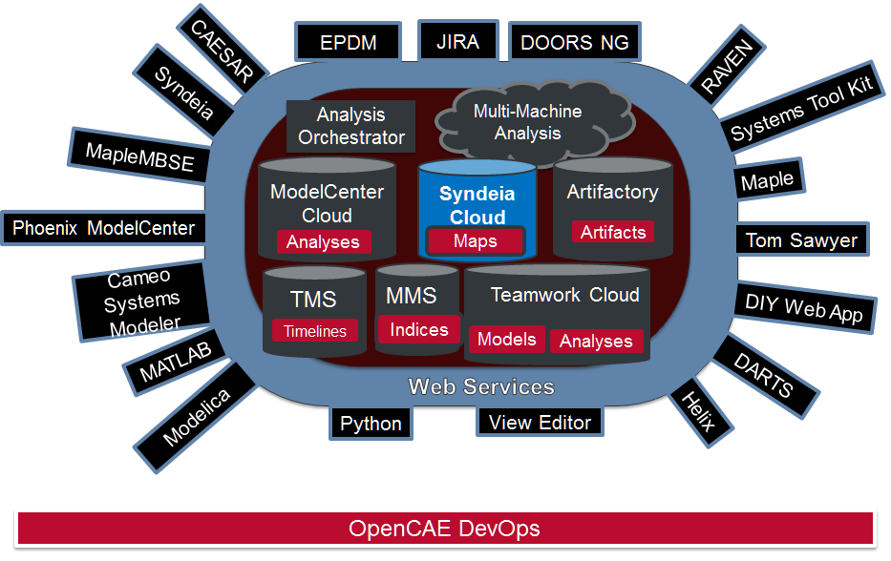
JPL/CAE Systems Environment provides integrated Life-Cycle Support
Process
Data Collection/
Deconfliction
Requirements
Analysis
Publish
Notes:
Different data sources, sub systems, deconflicted, mbe gives excel interface, syndeia provides multi-disciplinary integration, datahub AWC and mechanical world

Slide 15
JPL develops requirements for Systems Environment (tooling) through Case Studies
For Example:
Requirements Management
Interface Management
Design Management
Trade Studies
Interdisciplinary Integration
Analysis Pipeline
Resource Management
Timeline Management
Notes:
Working with users, line -> requirements sets, designs -> explore and expand

Slide 16
Open Model Based Engineering Environment
Using tools from OpenMBEE community
OpenMBEE is a community for open-source modeling software and models
Open source software
MMS, ViewEditor, MDK
Open source models
TMT, OpenSE Cookbook
JPL is a participant and adopter of OpenMBEE software and models
Boeing, Lockheed, OMG, NavAir, Ford, Stevens, GaTech, ESO, TMT, NASA
Vendors participate as well
~200 members, annual INCOSE workshop
www.openmbee.org

Slide 17
Pattern Structure
Every pattern follows the same structure
Intent
Motivation
Concept
Consequences
Implementation
Known Uses
Tooling
Related Patterns
Notes:
Intent A brief description of the problem which is addressed by the design pattern. The intent should prove useful when searching through design patterns, and to quickly understand the purpose of the pattern.
Motivation Explains a representative problem of a broad class of problems that the pattern seeks to address. The representative problem is a widespread concern and not trivial. In addition, the Motivation provides conditions that must be satisfied in order for the pattern to be used. After the conditions have been satisfied, the goals that the designer is trying to fulfill can be met. Any complicating design aspects and design constraints will be mentioned as well.
Concept A description of the structure of the pattern using SysML diagrams. All elements are generalizations of those that appear in the specific example given in the Motivation view. Each element of the structure is described, and a description of their responsibilities, purpose, and important relationships/interactions among participants are provided.
Consequences A description of the results, side effects, and trade-offs caused when applying the design pattern to the modeler's system. The actions and the positive or negative consequences are described. Additionally, a listing of possible conflicts that can occur while applying or using the pattern are provided. The possible scenario is described, and an explanation of the conflict is provided. It should be understood to the reader of the design patterns that both positive and negative consequences could occur. The designs are a compromise between available options and no design can avoid some negative consequence.
Implementation A sample model for instructional purposes that addresses the problem which is presented in the Motivation view. The example illustrates in detail how the pattern is applied a the particular problem.
Known Uses Other efforts that have dealt with the design problem which is addressed by the design pattern. An example system may have used a variation or the same design pattern as a solution.
Tooling Tooling information that can aid the implementation of the pattern is provided. Note, the information provided is meant only to aid and provide a faster method for implementing an aspect of the pattern. Tooling support is provided in several ways. If a specific software or plugin is recommended, information and links regarding such will be provided. Assuming the reader will proceed with the suggested tooling, screenshots of the expected input and output will be shown.
Related Patterns Other patterns from the Cookbook that could be used in combination with the selected pattern. The similarities and differences between the patterns serves to provide guidance as to which pattern may prove more useful.

Slide 18
Agenda
Introduction
TMT and MBSE Approach
Cookbook Principles
Selected Cookbook Patterns

Slide 19
Requirements Verification
Intent
Validate requirements, verify as designed system against requirements and publish analysis results
Cookbook Volume
System Requirements Management
Educational example
Autonomous Ferry Transportation
Known Uses
APS - Post-segment exchange timing requirements
Tooling
Cameo Systems Modeler and Simulation Toolkit, View Editor
Notes
Property Based Requirements links Requirements Management and System Design

Slide 20
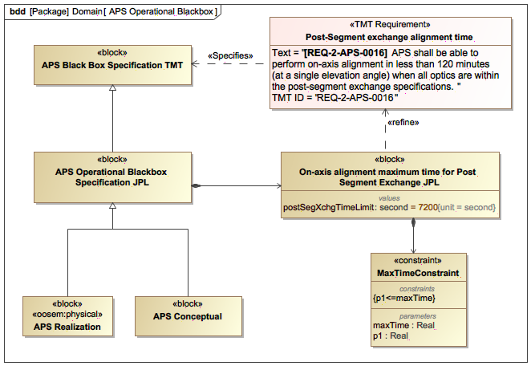
Formalizing Requirements with Property Based requirements
Mathematical re-formulation of requirement

Slide 21
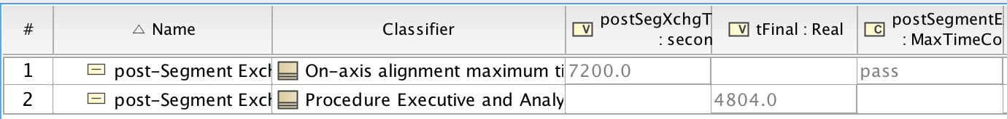
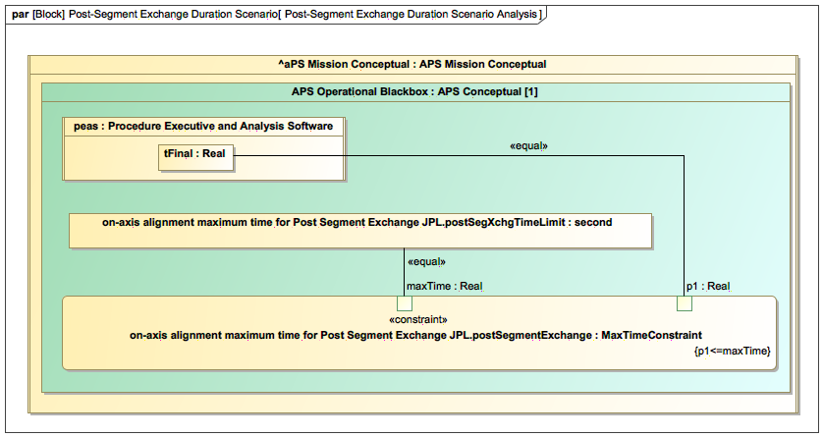
Verifying Timing Requirements by Simulation
Constraint is either violated or not

Slide 22
Monte Carlo Driven Analysis
Intent
Estimate the characteristics and probability of a particular behavior using modeling anchored through data.
Cookbook Volume
System Analysis Management
Educational example
Quadrupedal Robot
Known Uses
AO - Acquire a target with IRIS and NFIRAOS
Tooling
Cameo Systems Modeler and Simulation Toolkit, View Editor
Notes
SysML probability concepts and distributed properties capture operational knowledge in system model

Slide 23
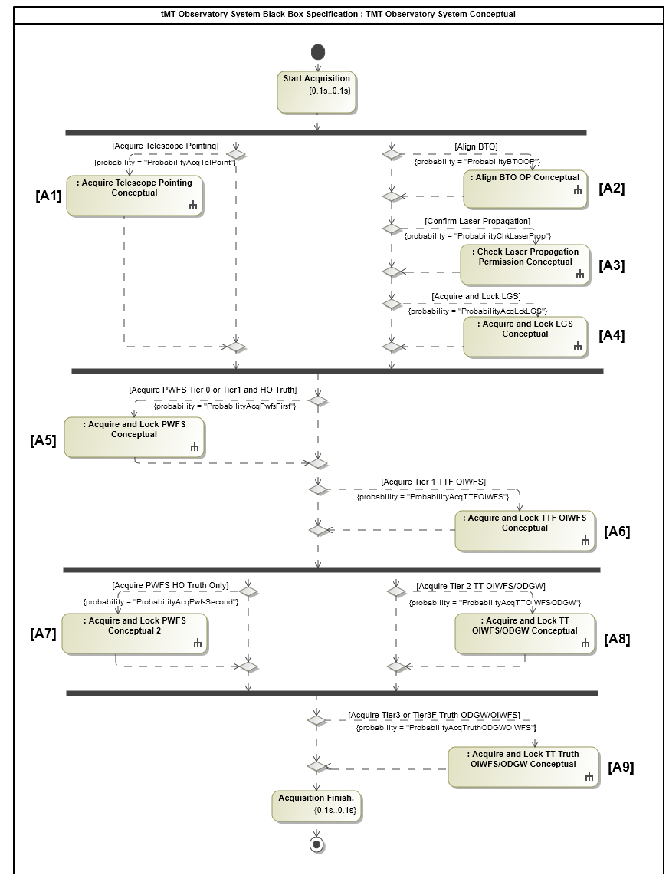
Behavior with Probabilities
TMT Observatory System Conceptual

Slide 24
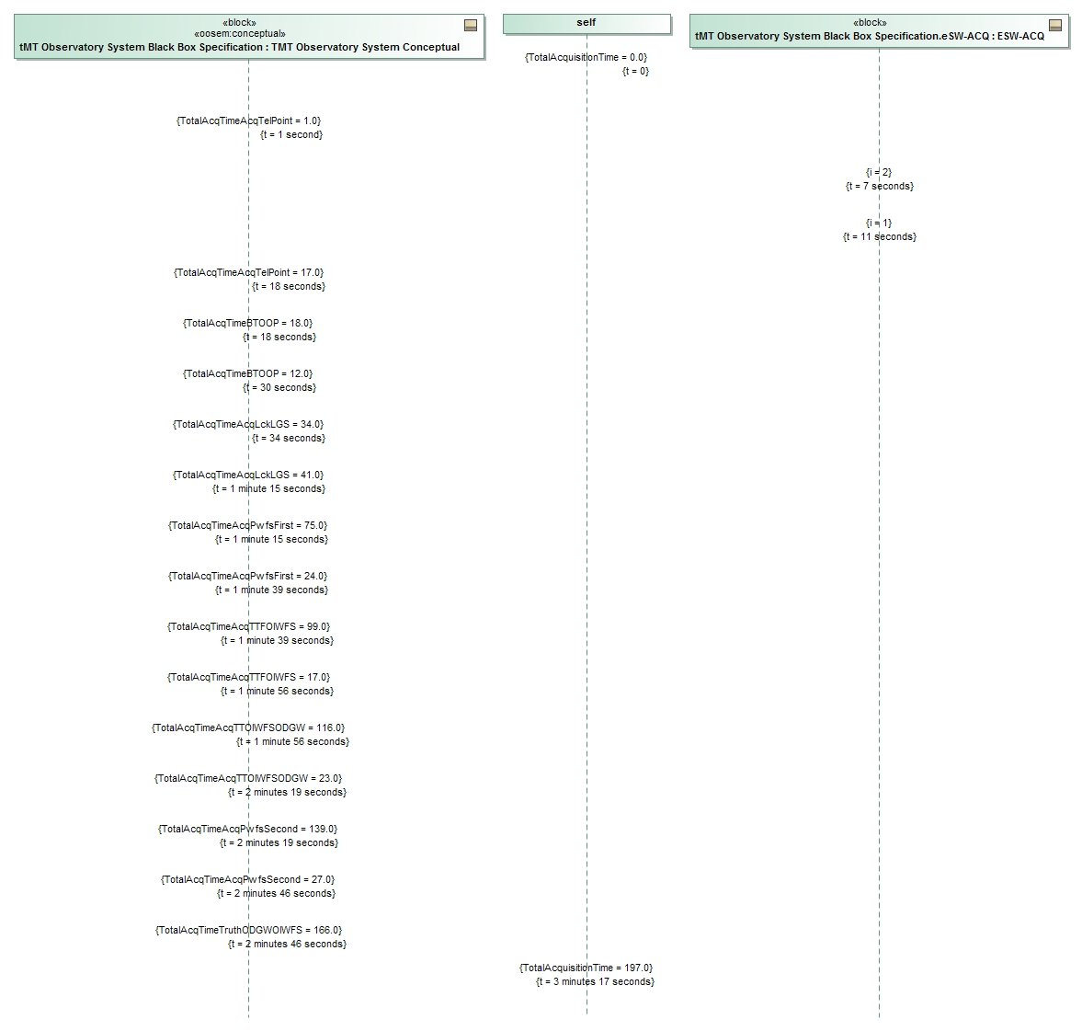
Resulting Trace
Probability Configuration Table

Slide 25
Error Budget Management
Intent
Manage error budgets of technical resources such as wave front error
Cookbook Volume
System Resource Management
Educational example
Microscope
Known Uses
APS - Alignment error of the M3 to APS interface
Tooling
Cameo Systems Modeler and Simulation Toolkit, View Editor

Slide 26
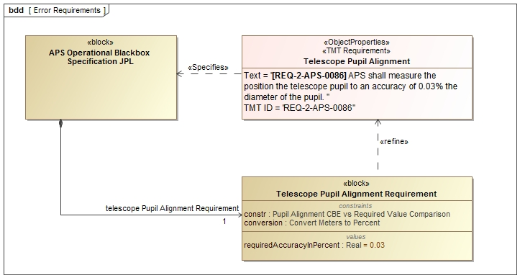
APS - Alignment error of the M3 to APS interface
Context

Slide 27
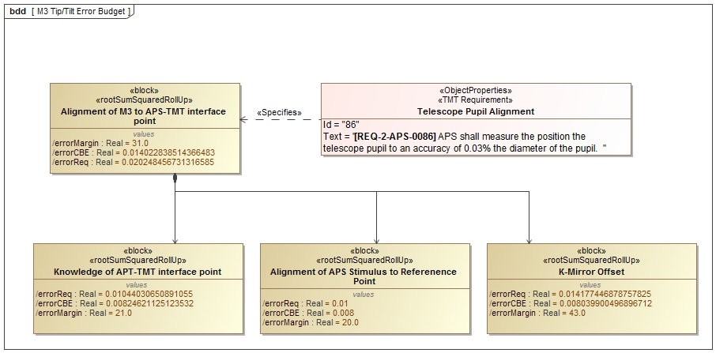
Specify RSS Tree
Application of pattern

Slide 28
Conclusions and Summary
OpenSE Cookbook addresses SE concerns, activities, and processes
Built on proven patterns from TMT and APE
Supported by tooling
Open for contributions and collaboration through INCOSE Telescope Challenge team
Accessible at https://mms.openmbee.org

Slide 29
Acknowledgements
This work was carried out at the Jet Propulsion Laboratory, California Institute of Technology, under a contract with the National Aeronautics and Space Administration.
The TMT Project gratefully acknowledges the support of the TMT collaborating institutions. They are the Association of Canadian Universities for Research in Astronomy (ACURA), the California Institute of Technology, the University of California, the National Astronomical Observatory of Japan, the National Astronomical Observatories of China and their consortium partners, and the Department of Science and Technology of India and their supported institutes. This work was supported as well by the Gordon and Betty Moore Foundation, the Canada Foundation for Innovation, the Ontario Ministry of Research and Innovation, the National Research Council of Canada, the Natural Sciences and Engineering Research Council of Canada, the British Columbia Knowledge Development Fund, the Association of Universities for Research in Astronomy (AURA) and the U.S. National Science Foundation.

Slide 30
References
OpenSE Cookbook: https://mms.openmbee.org/alfresco/mmsapp/mms.html#/projects/PROJECT-ID_2_2_17_7_33_25_AM_3ccfaf88_159fe0d7ba9__7d4e_cae_tw_jpl_nasa_gov_127_0_0_1/master/document/_18_5_2_e64033a_1513276256458_934885_22190
INCOSE SE2 Cookbook: https://mbse.gfse.de/documents/faq.html
Karban, R., Jankevičius, N., Elaasar, M. “ESEM: Automated Systems Analysis using Executable SysML Modeling Patterns”, (to appear in the proceedings of INCOSE International Symposium (IS), Edinburgh, Scotland, 2016.)
Karban R., Dekens F., Herzig S., Elaasar M, Jankevičius N., “Creating systems engineering products with executable models in a model-based engineering environment”, SPIE, Edinburgh, Scotland, 2016
Karban, R., “Using Executable SysML Models to Generate Systems Engineering Products”, NoMagic World Symposium, Allen, TX, 2016
Open Source TMT model: https://github.com/Open-MBEE/TMT-SysML-Model
Open Source Engineering Environment: https://www.openmbee.org
Docgen, ViewEditor, MMS: https://github.com/Open-MBEE/open-mbee.github.io/wiki/OpenMBEE-documentation
JPL Model-Based Systems Engineering Case Study: http://omgwiki.org/MBSE/lib/exe/fetch.php?media=mbse:incose_mbse_iw_2017:iw_2017_open_mbee.pdf
A Practical Guide to SysML, 3rd Edition, Chapter 17 by Friedenthal, Moore, and Steiner
https://www.jpl.nasa.gov/spaceimages/
INCOSE Telescope Challenge Team, http://omgwiki.org/MBSE/doku.php?id=mbse:telescope

Slide 31
BACKUP SLIDES

Slide 32
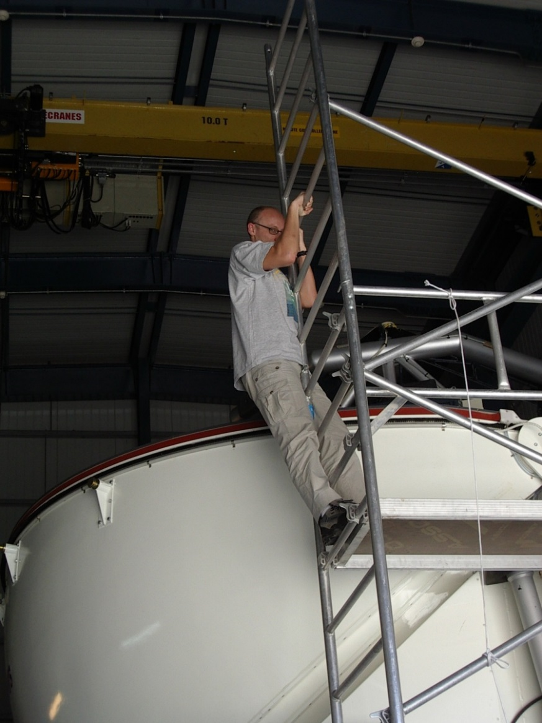
Who is Robert?
CAE Project Systems Engineer at NASA’s JPL - USA
Member of INCOSE
Co-Chair of the OMG SysML Revision Task Force
Formerly Control System/Software Engineer and Architect at:
European Southern Observatory – Germany, Chile
CERN – Switzerland/France
Siemens Healthcare - Austria
M.Sc. Computer Science (Austria)

Slide 33
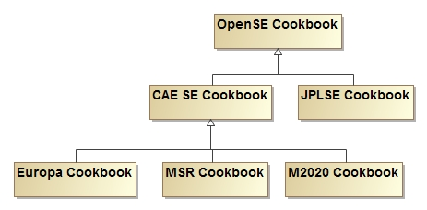
OpenSE Cookbook promotes re-use
OpenSE Cookbook contributes to JPL institutional and project specific Cookbooks
Project-independent modeling patterns as guidelines
Project-specific modeling patterns for common modeling tasks

Slide 34
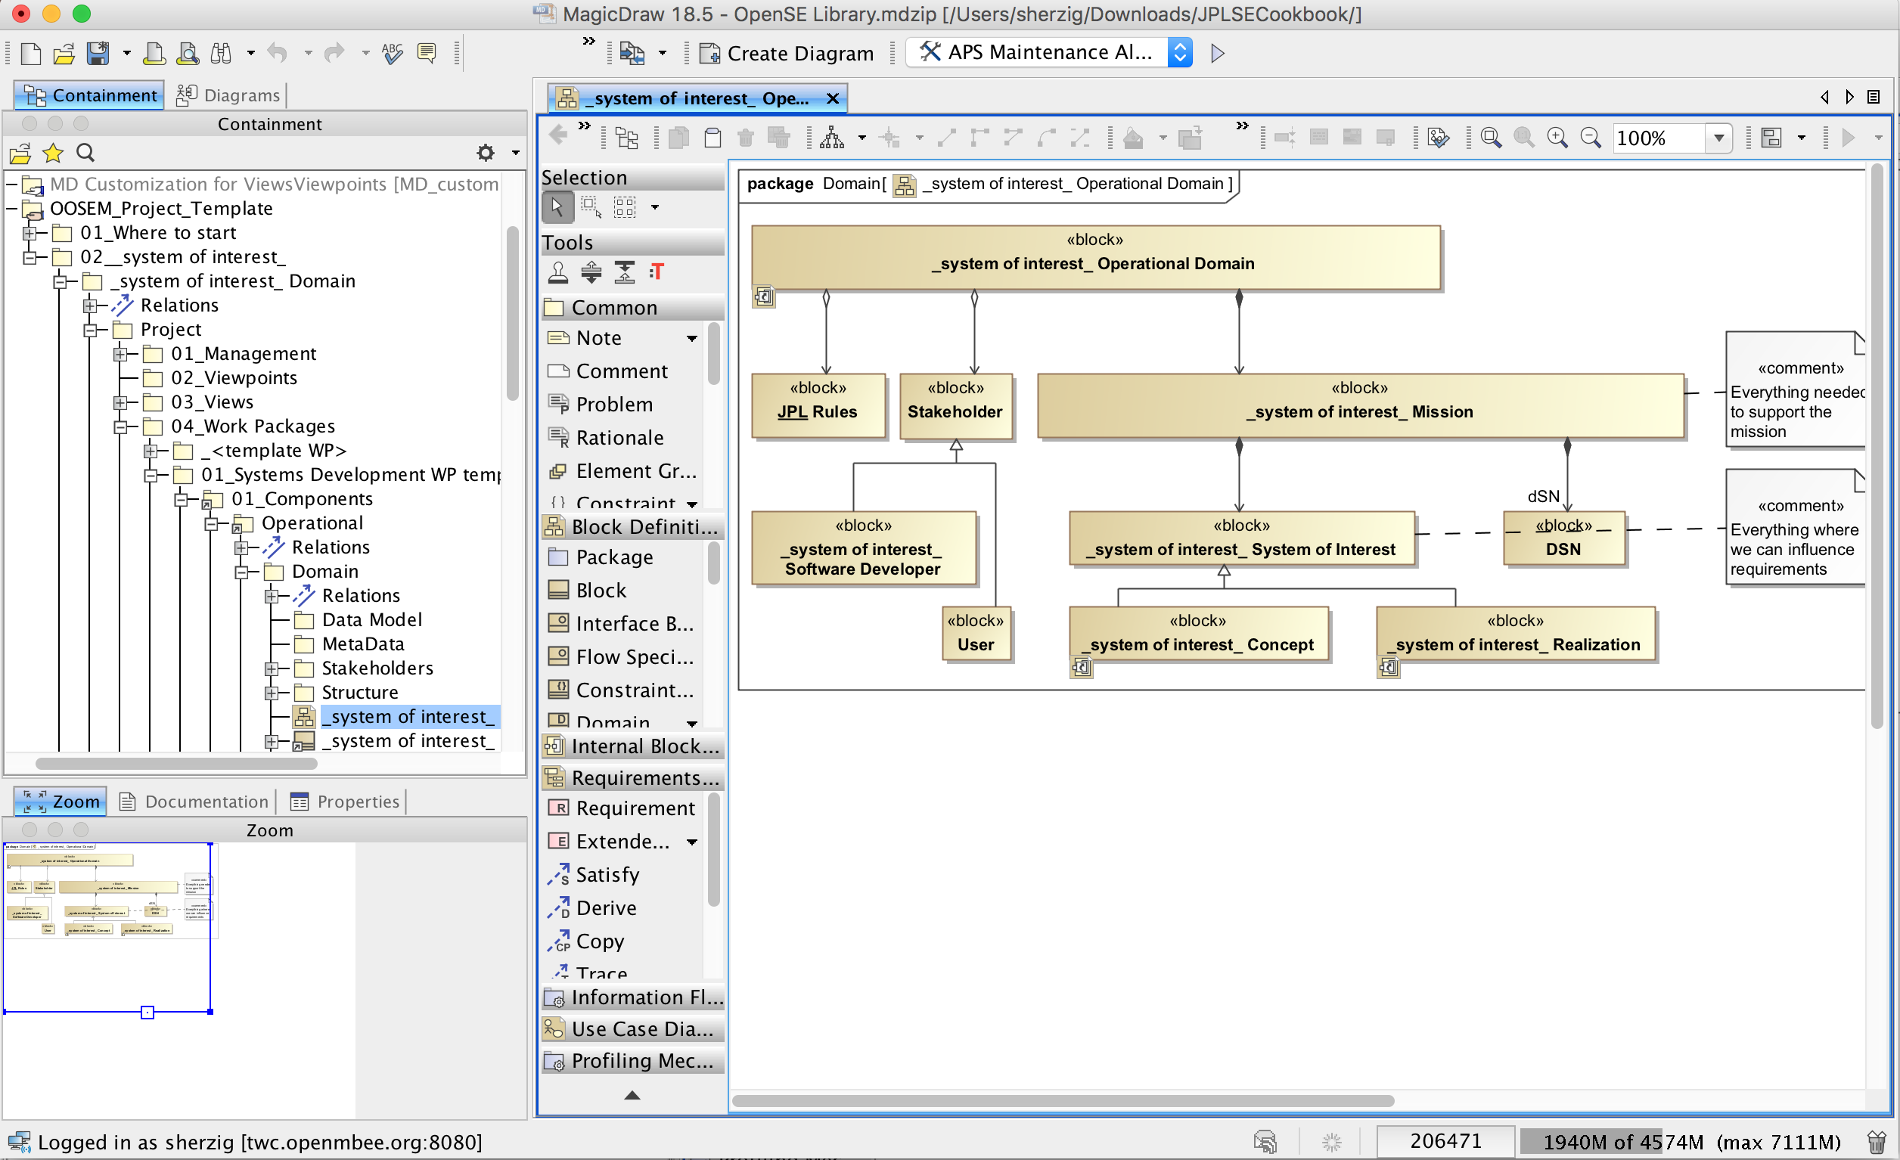
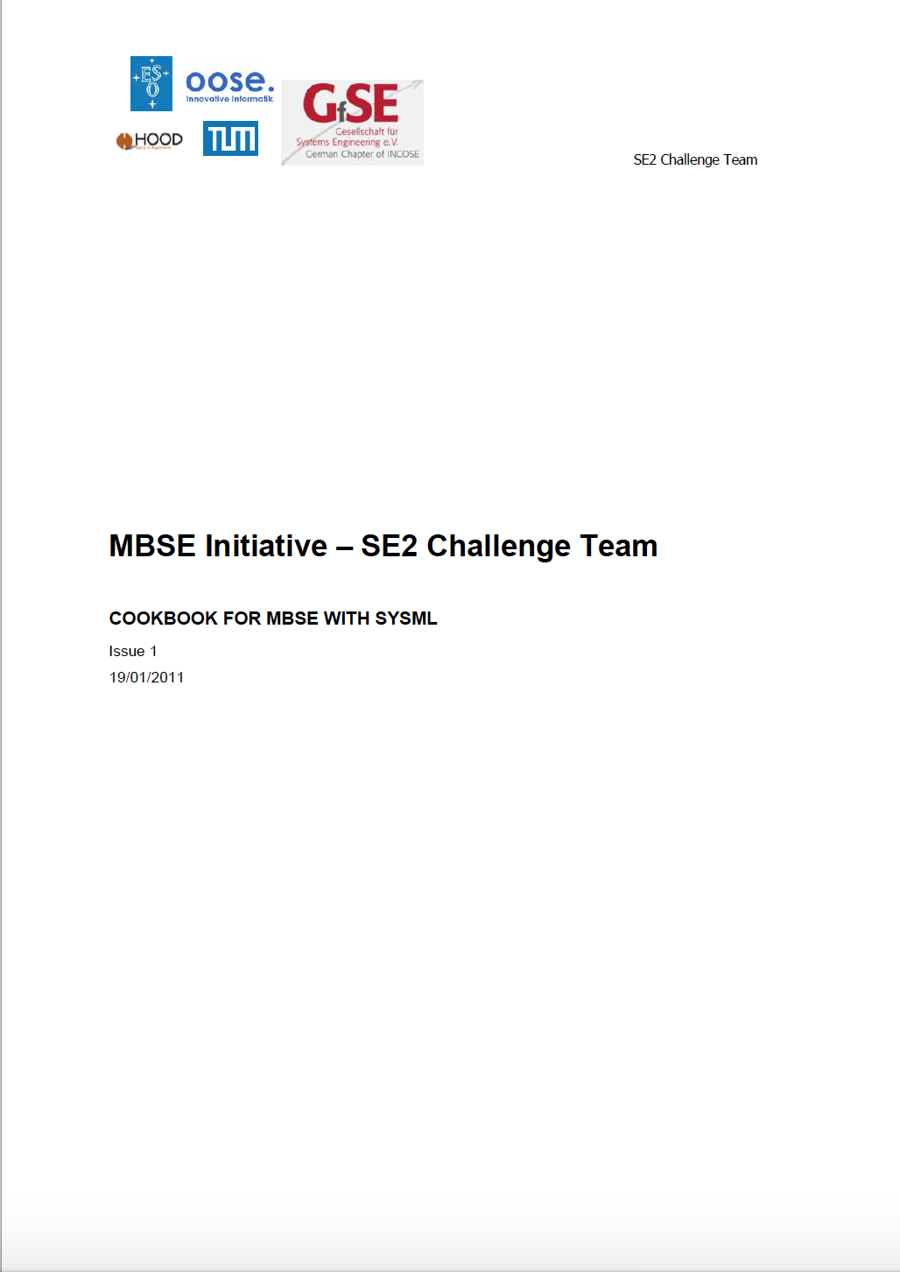
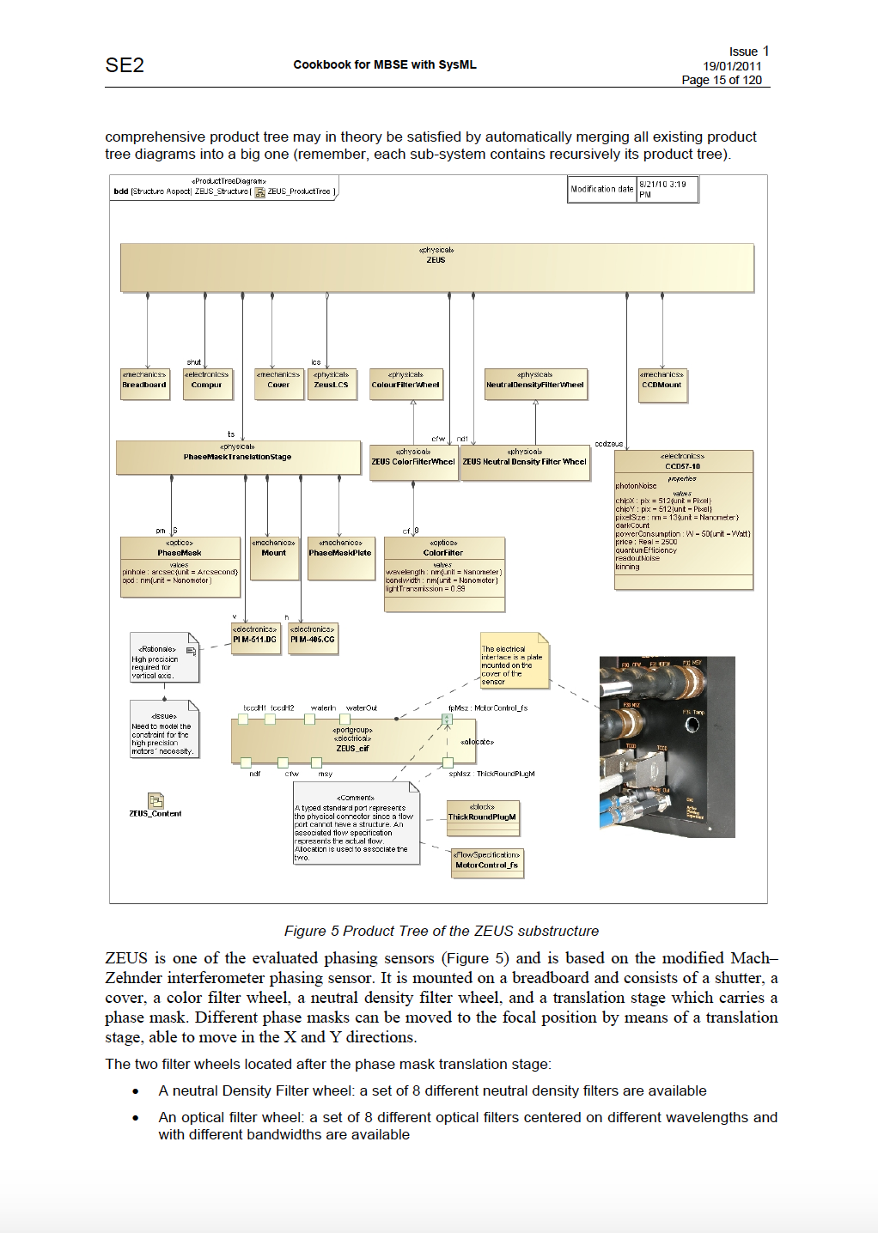
OpenSE Cookbook and Template Model
“Cookbook” for modeling methodology & patterns
Template models to be used by projects as a starting point, with recommended organization, model libraries, etc.

Slide 35
OpenSE Cookbook is used as reference
OpenSE cookbook and TMT model used as reference model for the OMG SysML 2 standard
Demonstrate how SysML 2 will improve, simplify, change model wrt SysML 1.x
Training material and knowledge transfer
Promote standards and conventions
Used by vendors as reference to test and evolve products

Slide 36
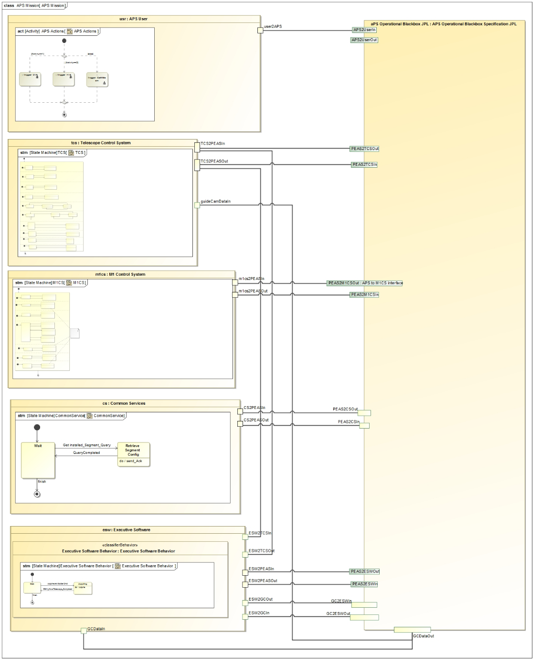
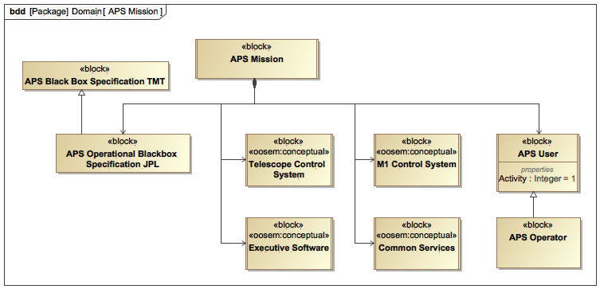
Define APS Mission boundaries
Operator
Modeled high-level behavior of interfacing components
TMT specification handed to JPL
TCS
APS Black Box
M1CS
CS
Interfaces between APS and other subsystems
JPL realization of APS
Other TMT Subsystems
ESW

Slide 37
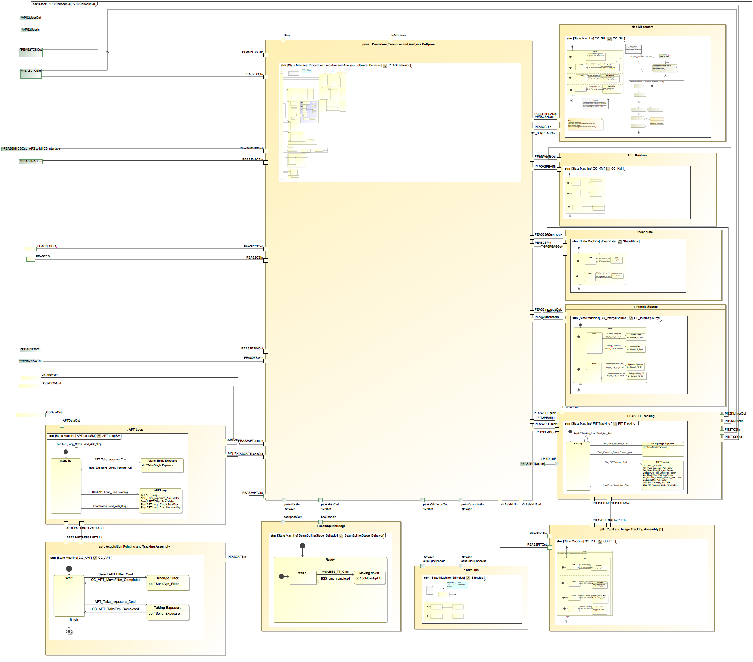
Elaborate Conceptual Architecture
Thirty Meter Telescope
SH Camera
APS conceptual is broken down into several components
Procedure Executive Analysis Software (PEAS)
Behavior of all interacting components modeled

Slide 38
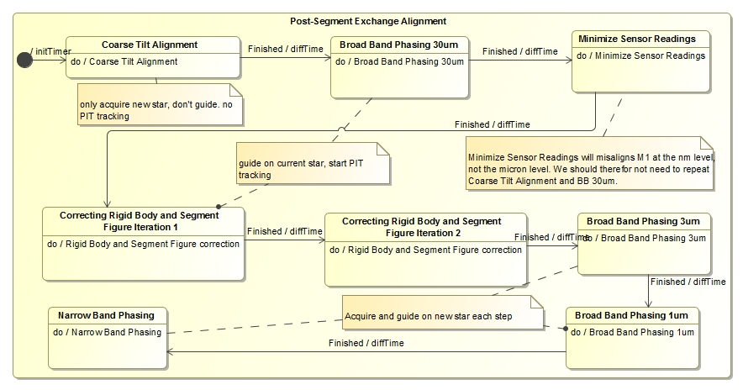
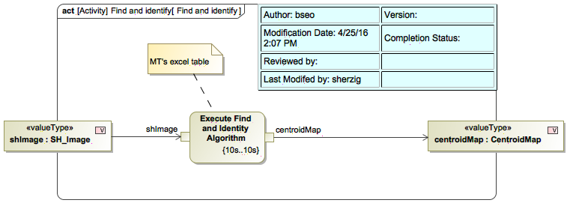
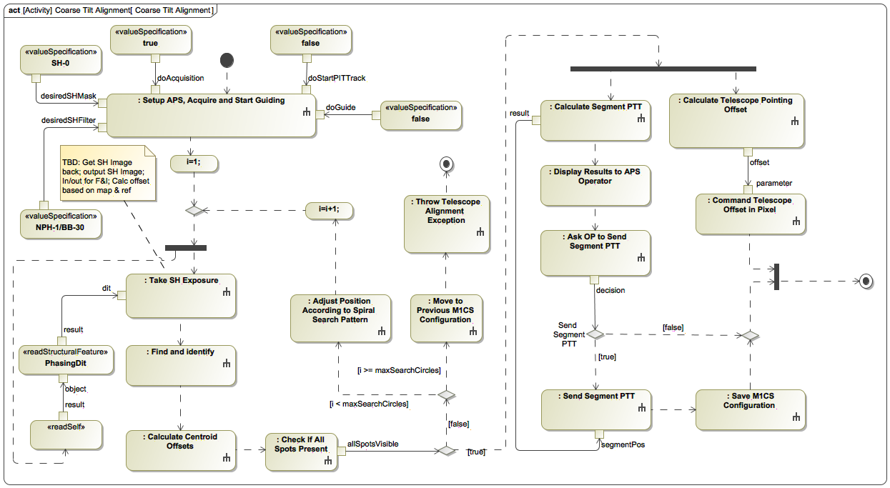
Capture Component Behavior and Characteristics
Thirty Meter Telescope
1
Operational behavior captured with state machines and activity models

Slide 39
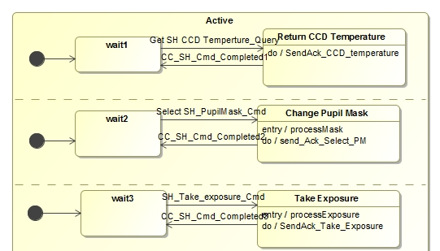
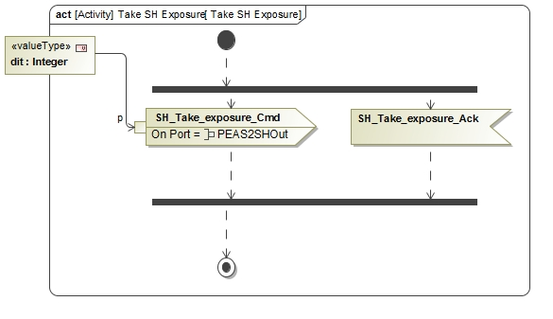
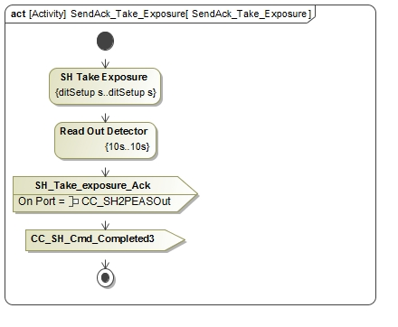
Specify Interactions Between Components
Thirty Meter Telescope
SH Camera Context
PEAS Context
Use of signals sent over ports to simulate a message passing mechanism between components
Also across subsystems! (e.g., APS to M1CS)

Slide 40
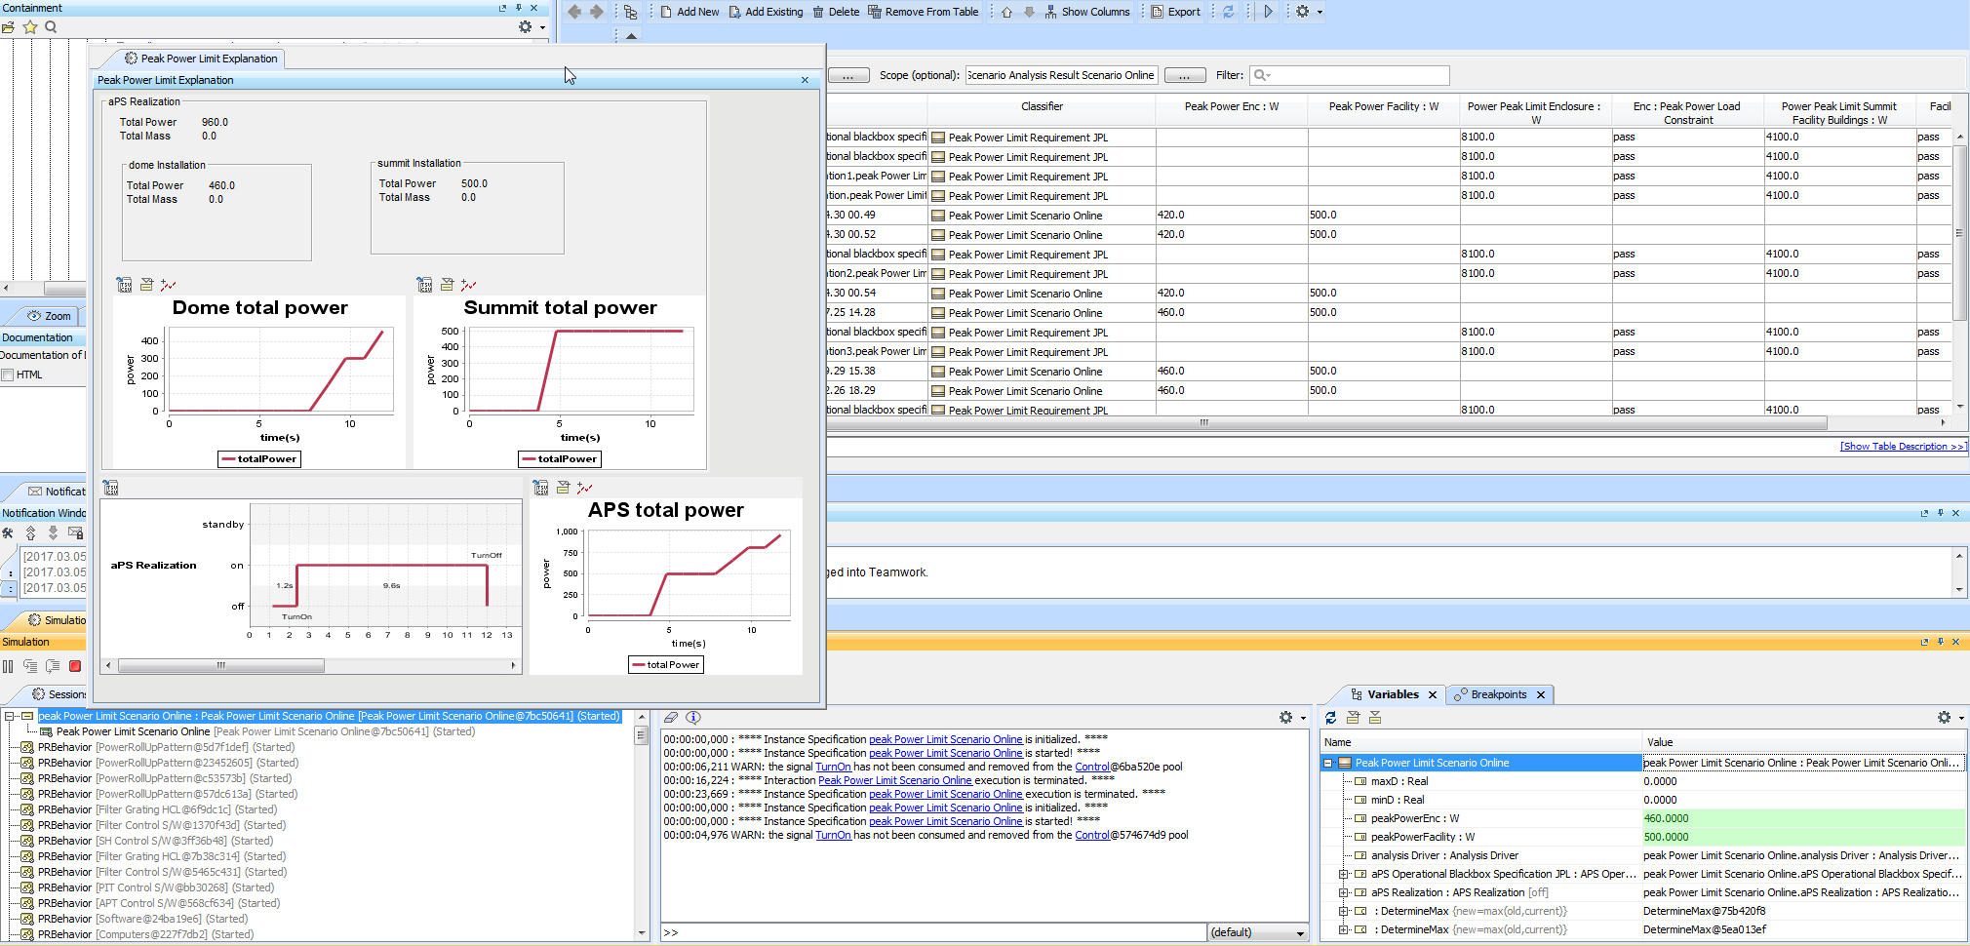
Run Analyses
Run a configured analysis with a simulation engine on the initial conditions to get the final conditions
Produce the analyses declaratively, repeatably (in any system), without a single line of project-specific code -> reducing time and resources
Produce the following views on final conditions
Table showing final analysis values (e.g. peak power) and the constraint’s pass/fail status for each scenario
Timelines: state changes for components over time
Value profiles: total rolled up values over time

Slide 41
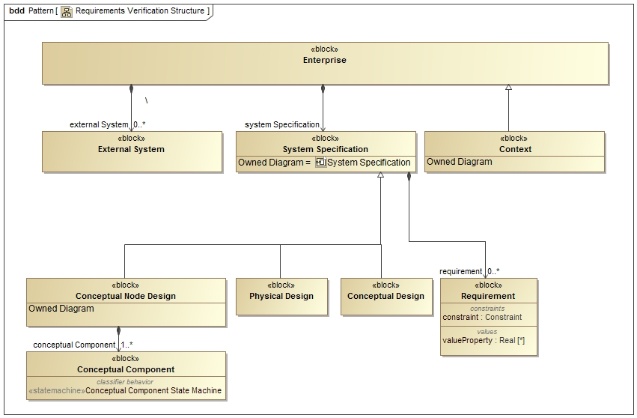
System Context

Slide 42
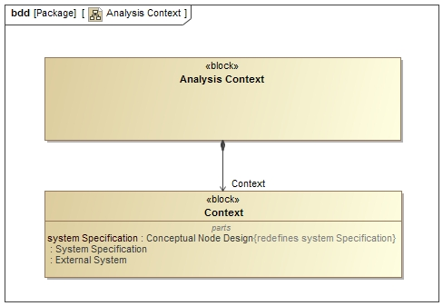
Analysis Context

Slide 43
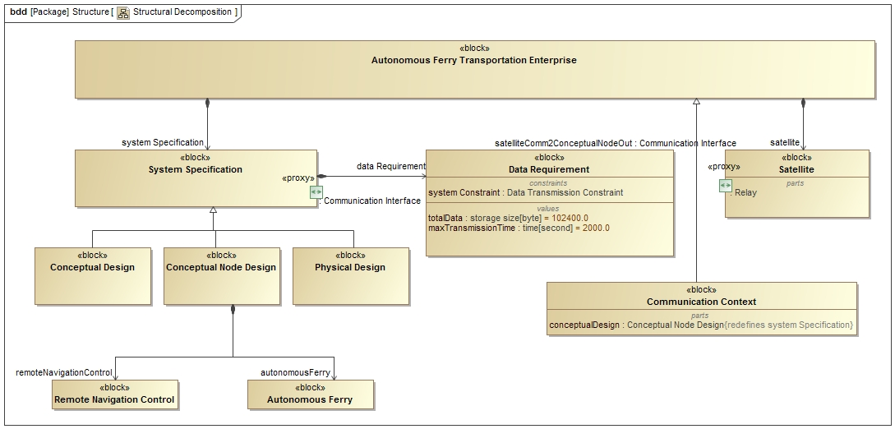
Context Educational Example

Slide 44
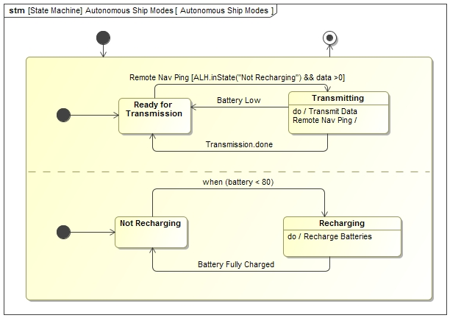
Behavior Ship

Slide 45
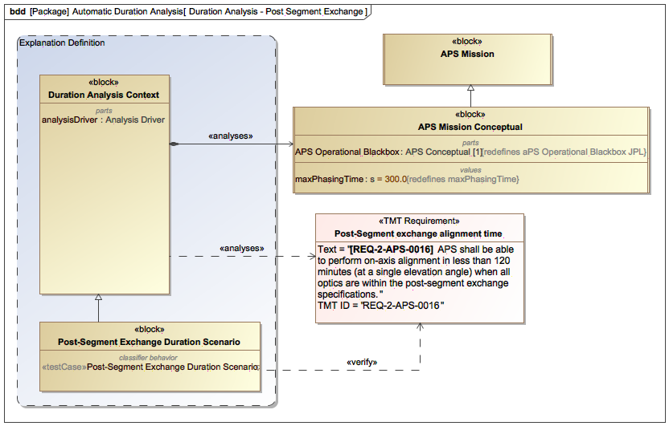
Verifying Timing Requirements by Simulation
Thirty Meter Telescope
Analysis context aggregates conceptual model, binds formalized requirement, and triggers verification use case

Slide 46
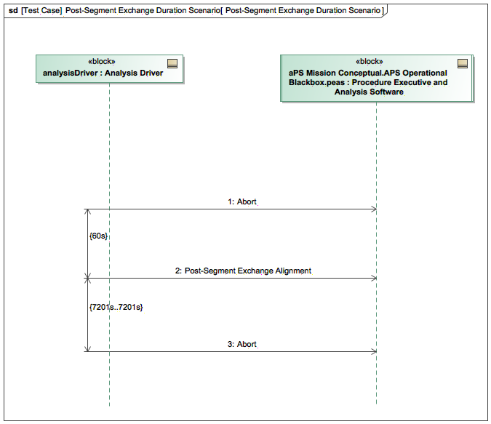
Verifying Timing Requirements by Simulation
Use case initiated with same message passing mechanism

Slide 47
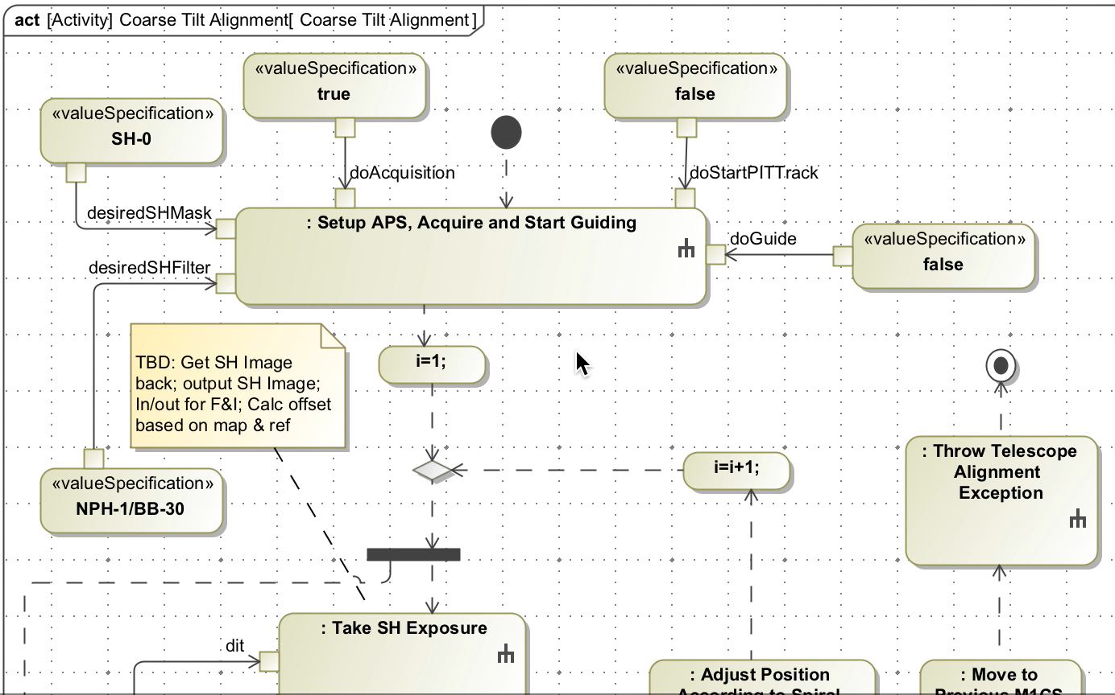
Verifying Timing Requirements by Simulation
Thirty Meter Telescope

Slide 48
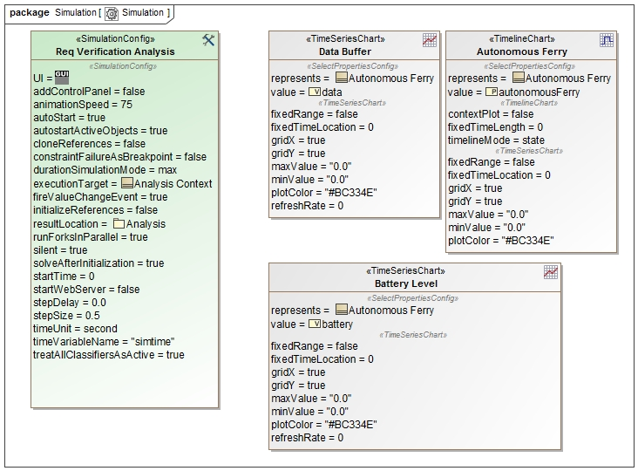
Simulation Configuration with Cameo

Slide 49
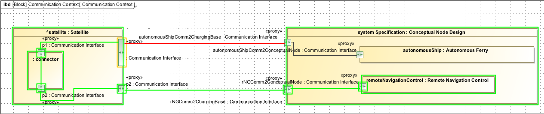
Executing a scenario

Slide 50
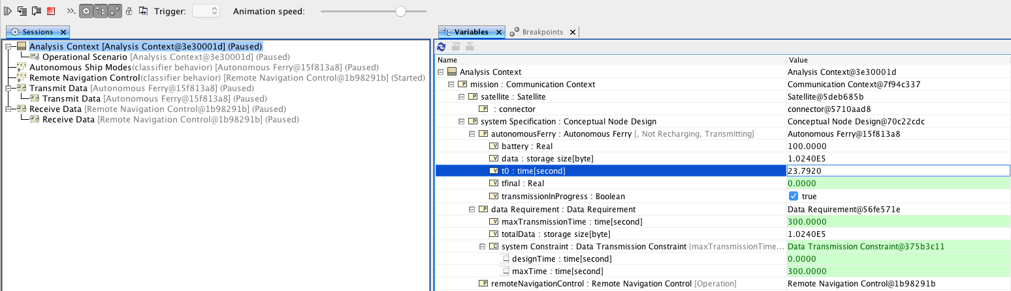
Simulation Run

Slide 51
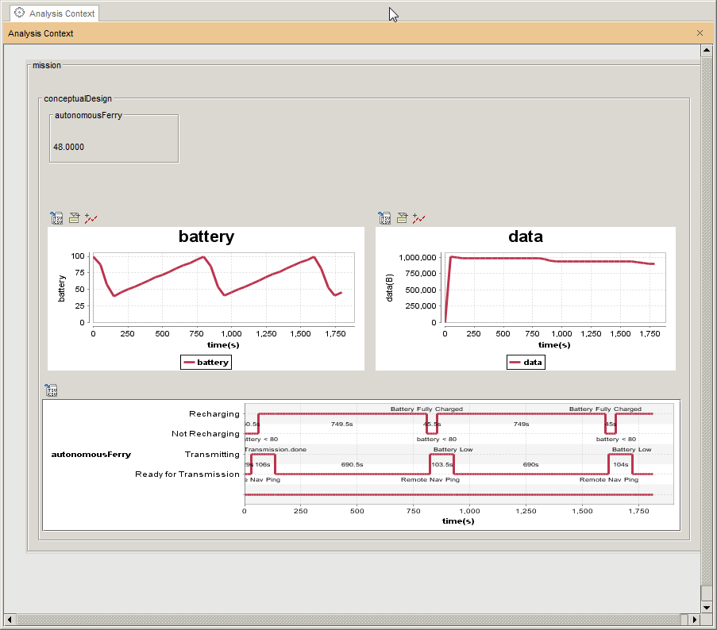
Analysis by Simulation

Slide 52
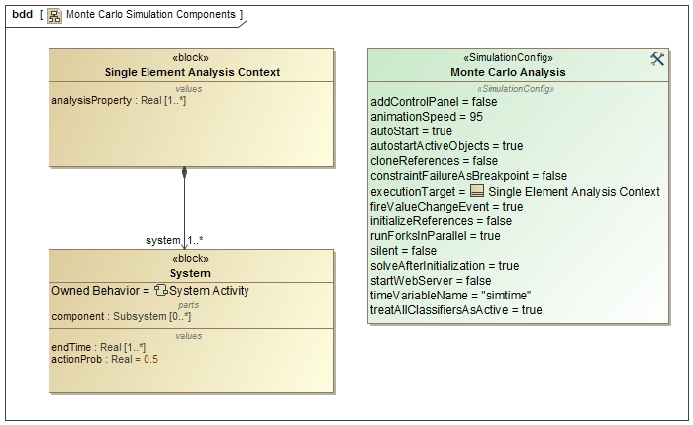
Single Element Analysis Context

Slide 53
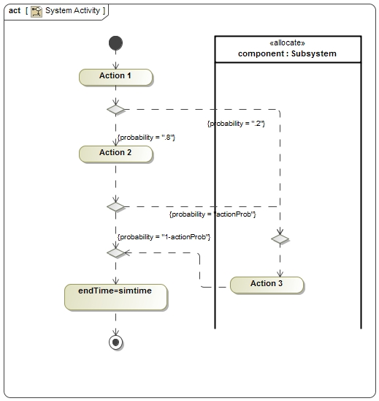
Behavior with Probablity

Slide 54
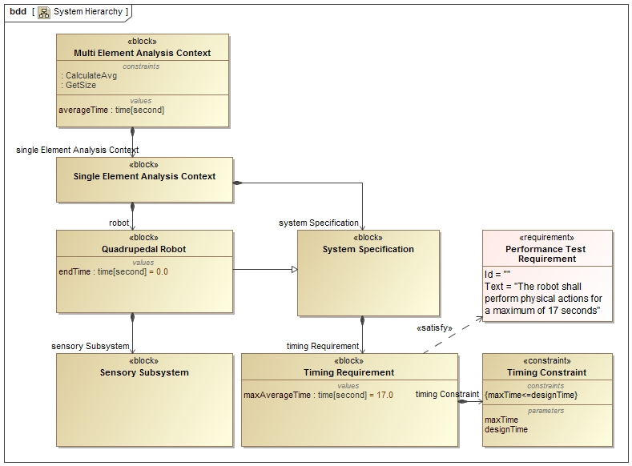
Example Quadrupedal Robot

Slide 55
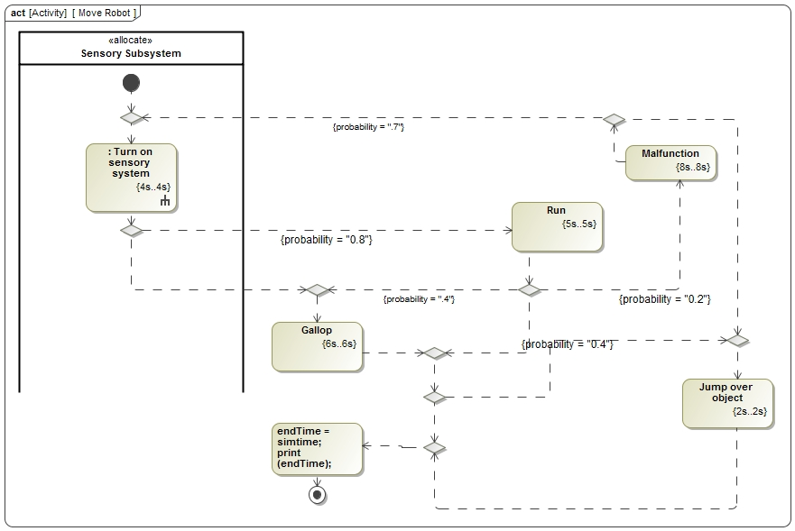
Behavior with probability

Slide 56
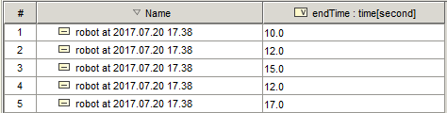
Individual Results

Slide 57
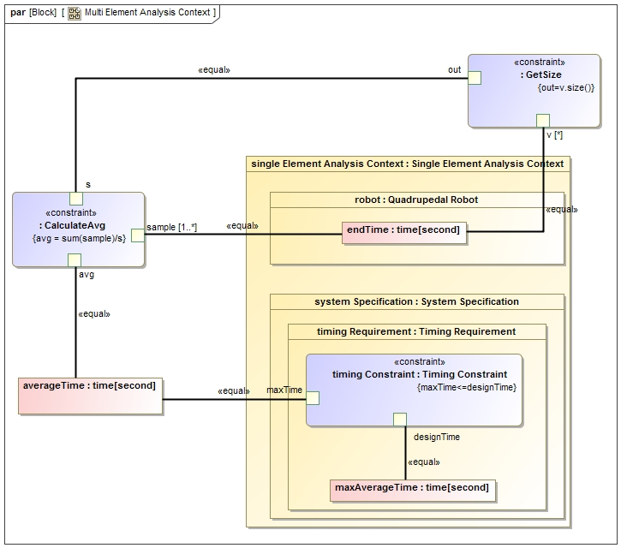
Analysis Context

Slide 58
Analysis Result

Slide 59
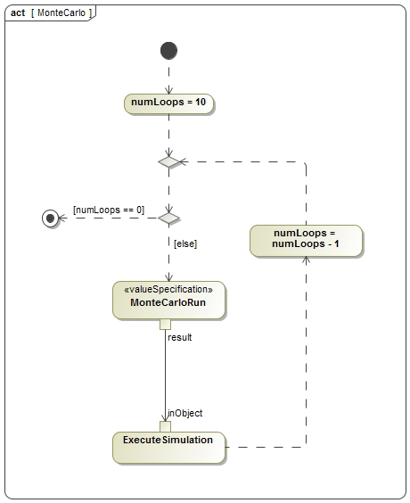
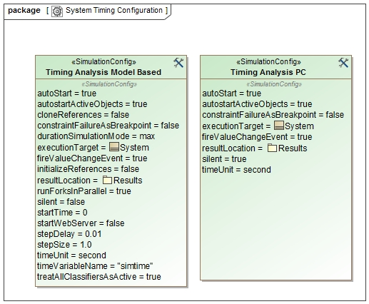

Cameo Simulation Toolkit

Slide 60

Error Roll-up Pattern

Slide 61

RSS Parametric Model

Slide 62
APS - Alignment error of the M3 to APS interface
Context

Slide 63
Specify RSS Tree
Application of pattern

Slide 64
OpenSE Cookbook promotes re-use
OpenSE Cookbook contributes to JPL institutional and project specific Cookbooks
Project-independent modeling patterns as guidelines
Project-specific modeling patterns for common modeling tasks

Slide 65
OpenSE Cookbook and Template Model
“Cookbook” for modeling methodology & patterns
Template models to be used by projects as a starting point, with recommended organization, model libraries, etc.

Slide 66
OpenSE Cookbook is used as reference
OpenSE cookbook and TMT model used as reference model for the OMG SysML 2 standard
Demonstrate how SysML 2 will improve, simplify, change model wrt SysML 1.x
Training material and knowledge transfer
Promote standards and conventions
Used by vendors as reference to test and evolve products

Slide 67
Define APS Mission boundaries
Operator
Modeled high-level behavior of interfacing components
TMT specification handed to JPL
TCS
APS Black Box
M1CS
CS
Interfaces between APS and other subsystems
JPL realization of APS
Other TMT Subsystems
ESW

Slide 68
Elaborate Conceptual Architecture
Thirty Meter Telescope
SH Camera
APS conceptual is broken down into several components
Procedure Executive Analysis Software (PEAS)
Behavior of all interacting components modeled

Slide 69
Capture Component Behavior and Characteristics
Thirty Meter Telescope
1
Operational behavior captured with state machines and activity models

Slide 70
Specify Interactions Between Components
Thirty Meter Telescope
SH Camera Context
PEAS Context
Use of signals sent over ports to simulate a message passing mechanism between components
Also across subsystems! (e.g., APS to M1CS)

Slide 71
Run Analyses
Run a configured analysis with a simulation engine on the initial conditions to get the final conditions
Produce the analyses declaratively, repeatably (in any system), without a single line of project-specific code -> reducing time and resources
Produce the following views on final conditions
Table showing final analysis values (e.g. peak power) and the constraint’s pass/fail status for each scenario
Timelines: state changes for components over time
Value profiles: total rolled up values over time

Slide 72
System Context

Slide 73
Analysis Context

Slide 74
Context Educational Example

Slide 75
Behavior Ship

Slide 76
Verifying Timing Requirements by Simulation
Thirty Meter Telescope
Analysis context aggregates conceptual model, binds formalized requirement, and triggers verification use case

Slide 77
Verifying Timing Requirements by Simulation
Use case initiated with same message passing mechanism

Slide 78
Verifying Timing Requirements by Simulation
Thirty Meter Telescope

Slide 79
Simulation Configuration with Cameo

Slide 80
Executing a scenario

Slide 81
Simulation Run

Slide 82
Analysis by Simulation

